Slide 1
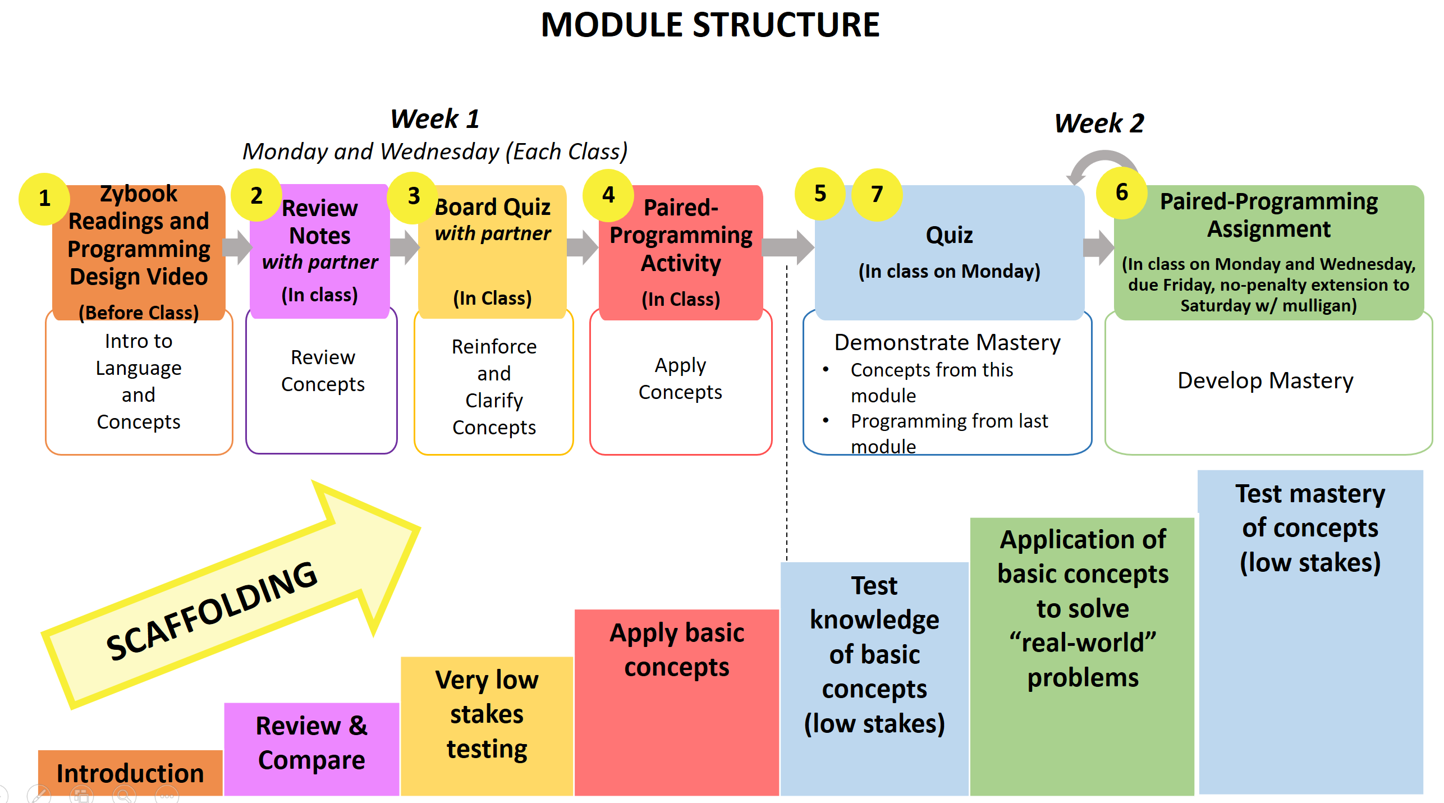
EE 2450 – Embedded System Programming 1: Course Structure

Slide 2
EE 2450 - Learning Activities to Engage Students
Before – In Person
Note Taking
- Cornell Notes
- Notes from reading
- Review w/ partner
Board Quiz
- Concept review
- On small whiteboard
- With partner
- Participation points
Practice Programs
- More/Simple programs
- Paired programming
- In zyBooks zyLabs
- Graded automatically

Slide 3
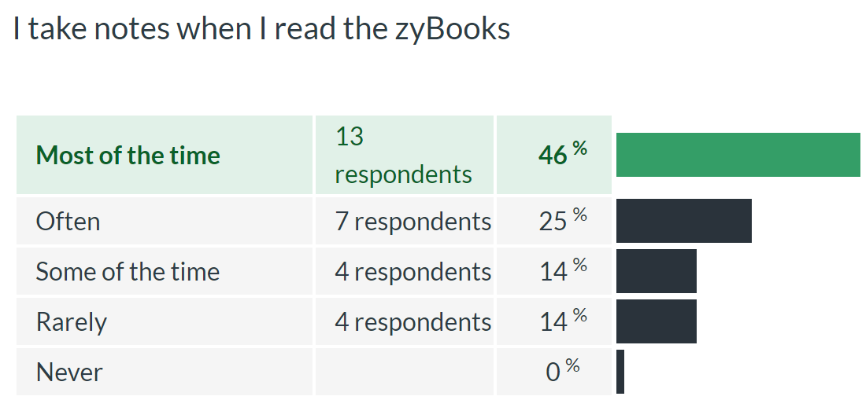
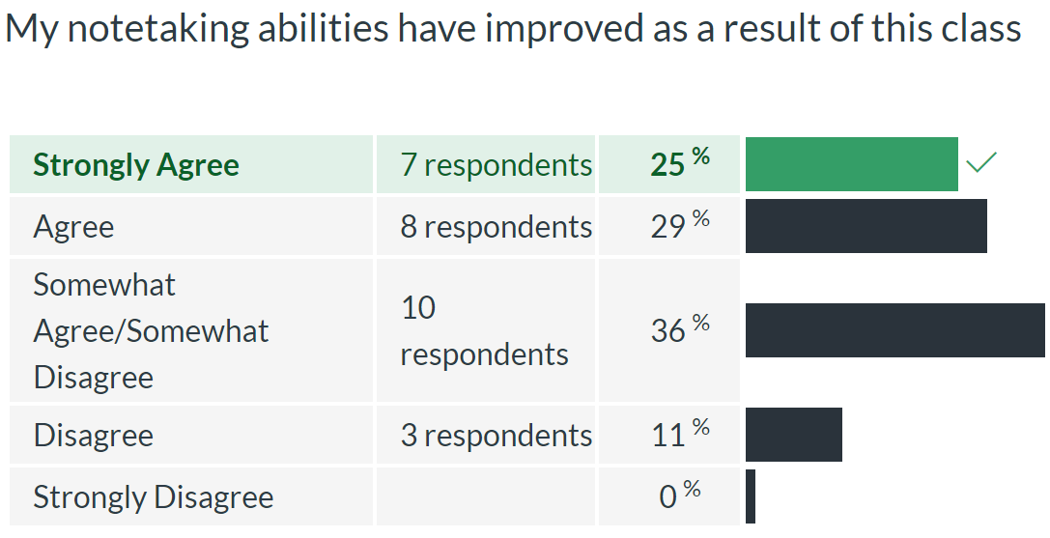
EE 2450 - Learning Activities to Engage Students
Before – In Person
Note Taking
- Cornell Notes
- Notes from reading
- Review w/ partner
Board Quiz
- Concept review
- On small whiteboard
- With partner
- Participation points
Practice Programs
- More/Simple programs
- Paired programming
- In zyBooks zyLabs
- Graded automatically

Slide 4
EE 2450 - Learning Activities to Engage Students
Before – In Person
After – Remote
Note Taking
- Cornell Notes
- Notes from reading
- Review w/ partner
Note Taking
- Wasn’t discussed
- No follow through
Board Quiz
- Concept review
- On small whiteboard
- With partner
- Participation points
Board Quiz
- Breakout rooms w/Google Doc (tried Canvas Collaborations)
Practice Programs
- More/Simple programs
- Paired programming
- In zyBooks zyLabs
- Graded automatically
(participation points)
Practice Programs
- Often ran out of time
- In breakout rooms w/
partner
- Solo after class

Slide 5
EE 2450 - Learning Activities to Engage Students
Before – In Person
After – Remote
Planned Remote
Note Taking
- Cornell Notes
- Notes from reading
- Review w/ partner
Note Taking
- Wasn’t discussed
- No follow through
Note Taking
- 5 Methods (Video)
- Discussion Board
Activity (3/semester)
Mulligan
Gift Card
Board Quiz
- Concept review
- On small whiteboard
- With partner
- Participation points
Board Quiz
- Breakout rooms w/Google Doc (tried Canvas Collaborations)
Canvas Practice Quiz
- Concept review
- Before class
- Participation points
- Unlock PPs in Canvas
Practice Programs
- More/Simple programs
- Paired programming
- In zyBooks zyLabs
- Graded automatically
(participation points)
Practice Programs
- Often ran out of time
- In breakout rooms w/
partner
- Solo after class
Practice Programs
- In breakout rooms w/
screen sharing
- Paired programming
- Announce switch partner
- Students request help

Slide 6
EE 2450 - Learning Activities to Engage Students
Before – In Person
After – Remote
Planned Remote
Note Taking
- Cornell Notes
- Notes from reading
- Review w/ partner
Note Taking
- Wasn’t discussed
- No follow through
Note Taking
- 5 Methods (Video)
- Discussion Board
Activity (3/semester)
Mulligan
Gift Card
Board Quiz
- Concept review
- On small whiteboard
- With partner
- Participation points
Board Quiz
- Breakout rooms w/Google Doc (tried Canvas Collaborations)
Canvas Practice Quiz
- Concept review
- Before class
- Participation points
- Unlock PPs in Canvas
Flexibility – offer out of class option (student survey)
Practice Programs
- More/Simple programs
- Paired programming
- In zyBooks zyLabs
- Graded automatically
(participation points)
Practice Programs
- Often ran out of tirme
- In breakout rooms w/
partner
- Solo after class
Practice Programs
- In breakout rooms w/
screen sharing
- Paired programming
- Announce switch partner
- Students request help

