Slide 1
MATH xxxx
Title
Meet and Greet

Slide 2
Instructions
Please add a slide to introduce yourself. Include:
Your name (and nickname if you have one you want to use). You can add pronouns if you want.
A picture of yourself in which you are easily recognized
Your major
A hobby - what you like to do outside of school
Your career goal
Something surprising about you
Be creative - no need to follow my example

Slide 3
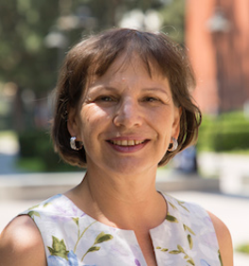
Combinatorial Games is my current research area. I switched to it because it is a very accessible area of mathematics for undergraduate students to do research in. And it is fun! So I am very excited that this semester the course attracted enough interest to run.
Career When I was in high school I wanted to be a high school math teacher (in Germany), but after a circuitous road through a Masters program in Applied mathematics geared toward industry and a number of seemingly random events I landed in Los Angeles and did a PhD at USC. And now I teach mathematics - just to a different audience!
I am a first generation student - my family owned a small hotel in which I grew up. I cleaned rooms, did laundry, worked in the kitchen, served breakfast, and made reservations.
Steeple of the Ulm Cathedral

Slide 4
Instructions for Use by Instructor:
Adapt to your course and put a slide about yourself (delete mine)
Delete this instruction slide
You can build on this activity by asking each student to find three other student with whom they have something in common and to comment on their shared characteristic/hobby/ etc.
Instead of Google slides, one could also set this up as a discussion in Canvas and then can comment in the discussion board.
Another follow up is a Jam Board, where you put students in groups and then they have to find as many things they have in common - group with most things in common (the more people have something in common, the better it is.
The simple version just has students put in random groups in breakout rooms and then the breakout room is the slide number.
A fancier version pastes the images from the slides into the jamboard pages and then students find their image and then the join the breakout room with that number. A sample Jamboard can be found in the Google drive.

