Slide 1
What Does it Take to Excel?

Slide 2
THINK (3 minutes)
On your own, think about the following
What activity outside of school do you excel at?
How did you come to excel at that activity?
What are some specific struggles you have had with the activity?
What did you learn from that struggle?
You may want to jot down some notes, as you will discuss with other classmate(s).

Slide 3
PAIR (5 minutes)
I will put you into groups of 2-3 in breakout rooms. In your group, first introduce yourself (name, maybe major). Then
Discuss the similarities and differences between how you came to excel at your activity
Discuss the similarities and differences of what you have learned from your struggles

Slide 4
SHARE (~5 minutes)
I will call on volunteers from the different groups to share one interesting thing you learned from your group discussion. Share either
How you or somebody in your group came to excel at an activity
What you or somebody in your group learned about their struggles.

Slide 5
DISCUSSION
Why do you think I gave you this activity?
Does any of what you discussed apply to learning mathematics?

Slide 6
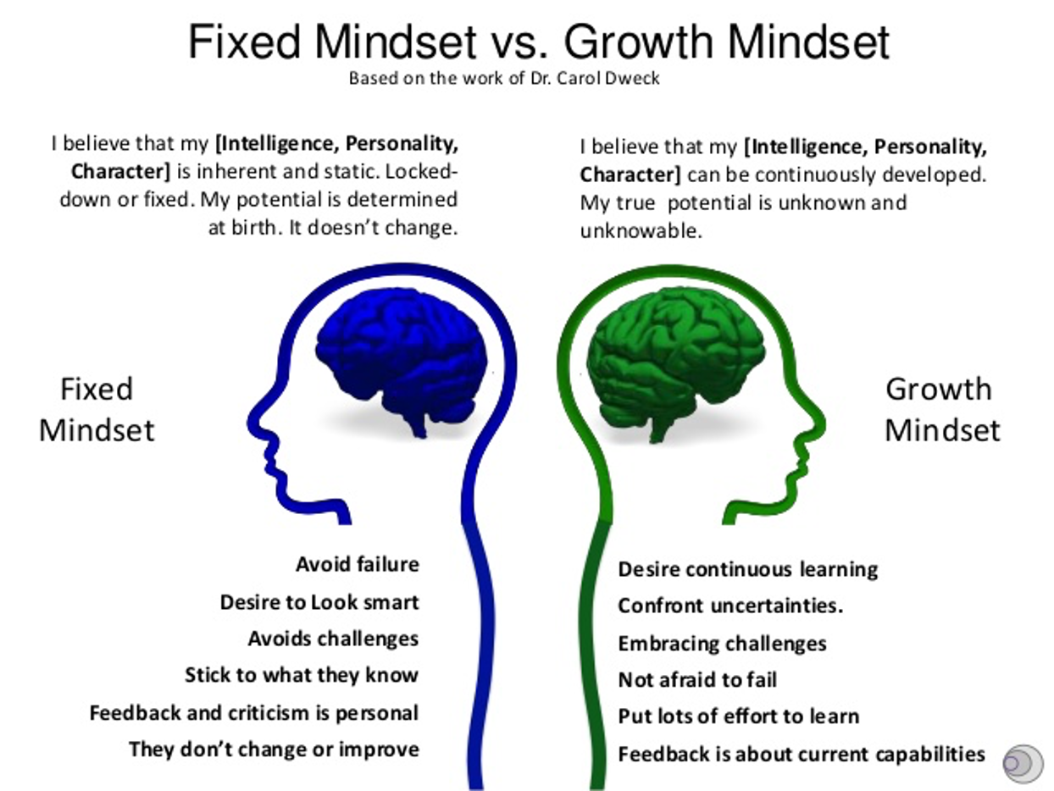
We can have different mindsets in different areas of our lives. With your chosen activity, did you start out thinking you would be good at it?
Notes:
We can have different mindsets in different areas of our lives. With your chosen activity, did you start out thinking you would be good at it?

