Slide 1
Scaffolded Learning Ideas
Stephanie E. August
Cal State LA ECST Teaching and Learning Seminar
February 26, 2021

Slide 2










Vygotsky’s Zone of Proximal Development
The difference between what a learner can do without help and what the learner can achieve with guidance. [1]
You can only learn that which you almost already know.
[1] McLeod, S. A. (2019). What Is the zone of proximal development?. Simply psychology. https://www.simplypsychology.org/Zone-of-Proximal-Development.html

Slide 3
CS 2010
Computer Programming Fundamentals

Slide 4
Multiple Small Problems Approach
Write any program
In-class exercises Week 3 Exercise 1 Week 3 Exercise 2 Week 3 Exercise 3
Input/Output and Conversion assignment
ThinkCSPy interactive text
Drawing with Turtle Graphics

Slide 5
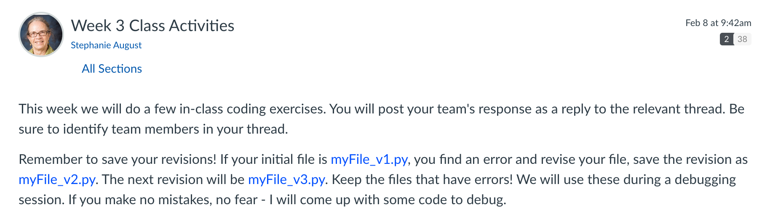
Week 3 CLass Activities

Slide 6
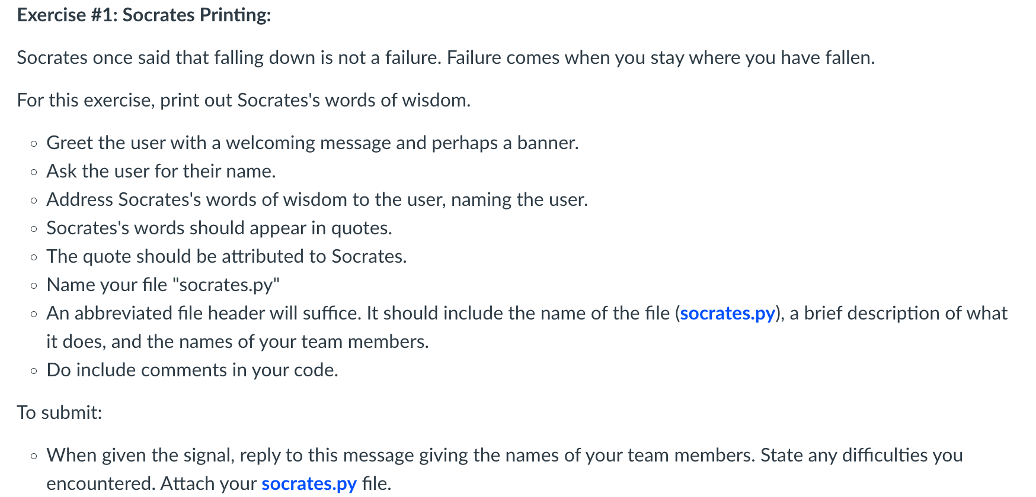
Week 3 Exercise 1

Slide 7
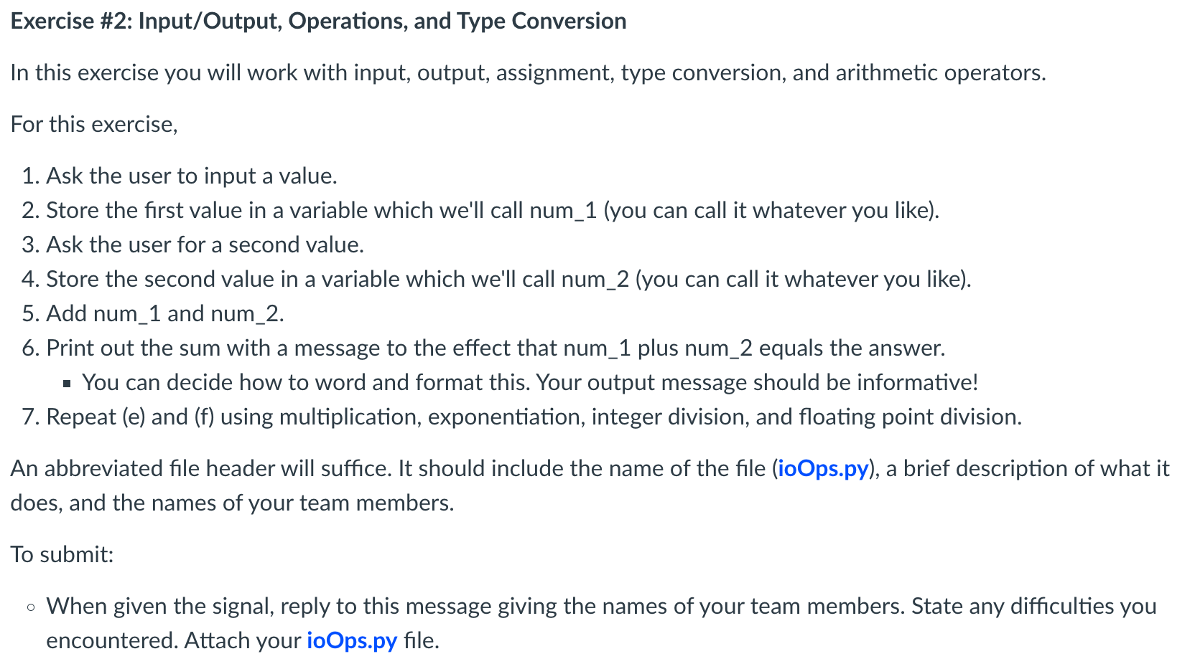
Week 3 Exercise 2

Slide 8
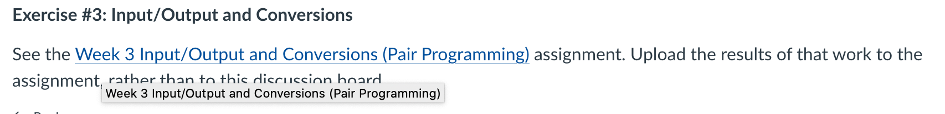
Week 3 Exercise 3

Slide 9
mini-portal development for non-computing students
Student: Complete assigned reading
Student: Bring blurb and image on topic to class
Instructor: Demo the lab procedure
Group: Follow step-by-step lab procedure to create a mini-web portal
Group: Complete a lab report recording each of their activities
Student: Repeat the lab activities on an individual basis
Student: Complete a lab report recording their results

Slide 10
Database project ACTIVITIES

Slide 11
Database project ACTIVITIES
Evolution of DBMS
Relational model
Relational operations
Entity-relationship diagrams
Data Manipulation Language
Data Definition Language
Data Control Language
Functional dependencies
Normalization
Integrity & Security
Query processing & optimization
Recovery, transaction mgmt
Describe the enterprise
Define the environment
Develop semantic data model
Define the database and formulate queries
Consider database integrity and security
Implement the database
Complete peer reviews
Demo database build, load, queries for instructor
Reflect: Lessons learned
Complete report and files containing design, tables, queries, traces

Slide 12
Wk Del Assignment Workshop
3 #1 Describe the enterprise
List queries
5 #2 Define the environment Modeling
Input and report forms
Assumptions
User-oriented data dictionary ERD-to-Table mapping
Peer review Cross-reference table
7 #3 Develop logical and conceptual models Reverse engineering
Entity-relationship diagram
Conceptual model (table designs)
Peer review Table and Attribute dictionaries Functional dependencies
9 #4 Define the database and formulate queries
Data definition statements (DDL)
Implementation of 10 queries in SQL
Design limitations
11 #5 Consider database integrity and security Normalization
Peer review
13 #6 Implement the database
Add the data and test the queries
15 #7 Lessons learned
15 final Completed notebook, upload or medium containing design, tables, queries, traces - everything needed to build, run, and test the project

